Slide 1

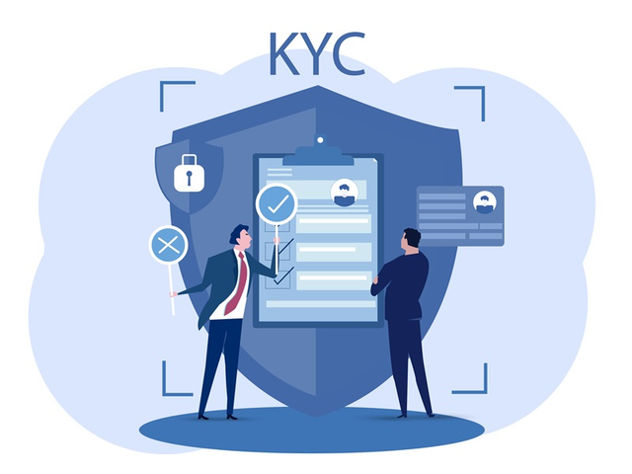
User KYC Verification platform
Team- MAVERICKS

Slide 2


Introduction to KYC Verification
KYC (Know Your Customer) verification is essential for preventing fraud and ensuring regulatory compliance.
This platform combines Flask for backend services and React for frontend interactions.
Focuses on live facial recognition, document verification, and a robust matching system.

Slide 3
Problem Statement
Need for authenticating users using real-time data.
Common challenges: photo spoofing, document forgery, and scalability.
This platform ensures user authenticity by using advanced image verification and liveness detection.

Slide 4
Workflow overview
1
2
3
4
Live photo capture through webcam.
User uploads an ID document and a second image for database comparison.
Backend compares live image with ID document and performs liveness detection.
The second image is checked against the database to find top similar faces.
Back to Agenda

Slide 5
Uses React to handle image capture via webcam and document upload.
Frontend Functionality
Sends data in real-time to the Flask backend.
Captures and displays liveness detection feedback to the user.

Slide 6
Receives the captured and uploaded images.
Backend
logic
Integrates with third-party APIs for facial recognition and liveness detection.
Sends comparison results to the frontend.

Slide 7
Technologies Used
Frontend: React, HTML5, CSS3, Webcam API.
Backend: Flask (Python), OpenCV, API integrations.
APIs: Facial recognition, document verification, liveness detection.
Libraries: DeepFace, OpenCV, TensorFlow (optional for future expansions).

Slide 8
Challenges Faced
Handling false negatives in liveness detection.
Ensuring image quality across different devices and lighting conditions.
Solution: Adaptive algorithms and robust testing for different scenarios.

Slide 9
Thank
you!

